Slide 1

Decomposition
Chris Piech
CS106A, Stanford University

Slide 2


Today’s Goal
Be able to approach a problem “top down” by using decomposition (aka top town refinement)

Slide 3
First, a cool program

Slide 4
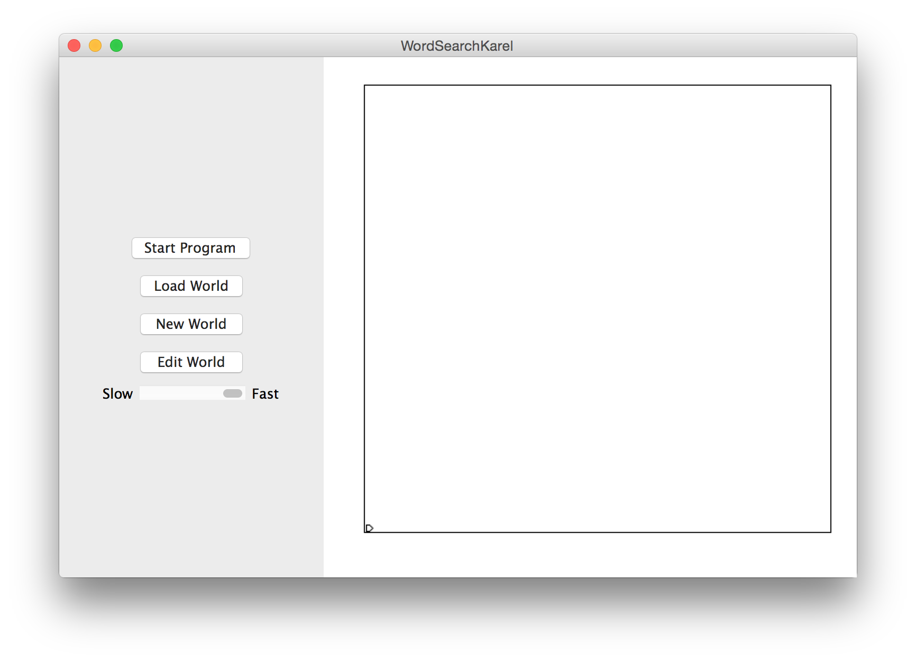

Slide 5
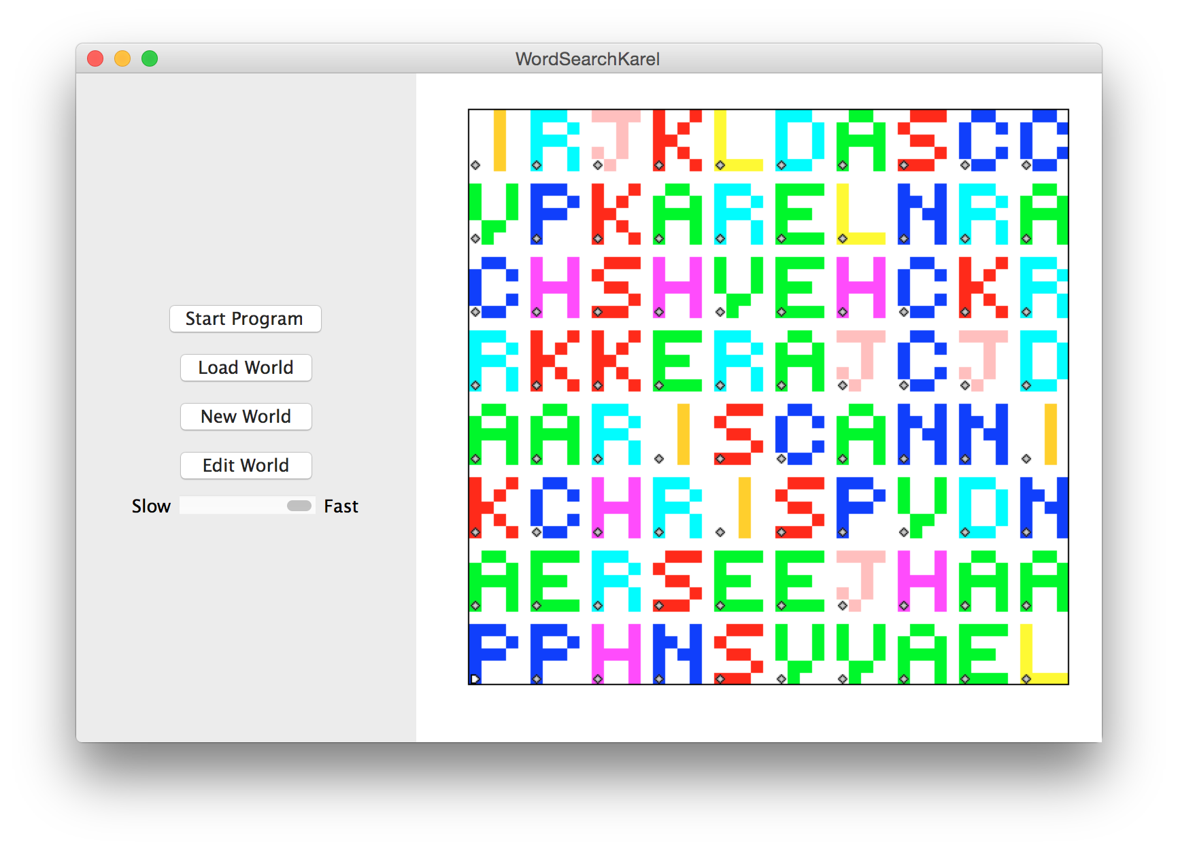

Slide 6
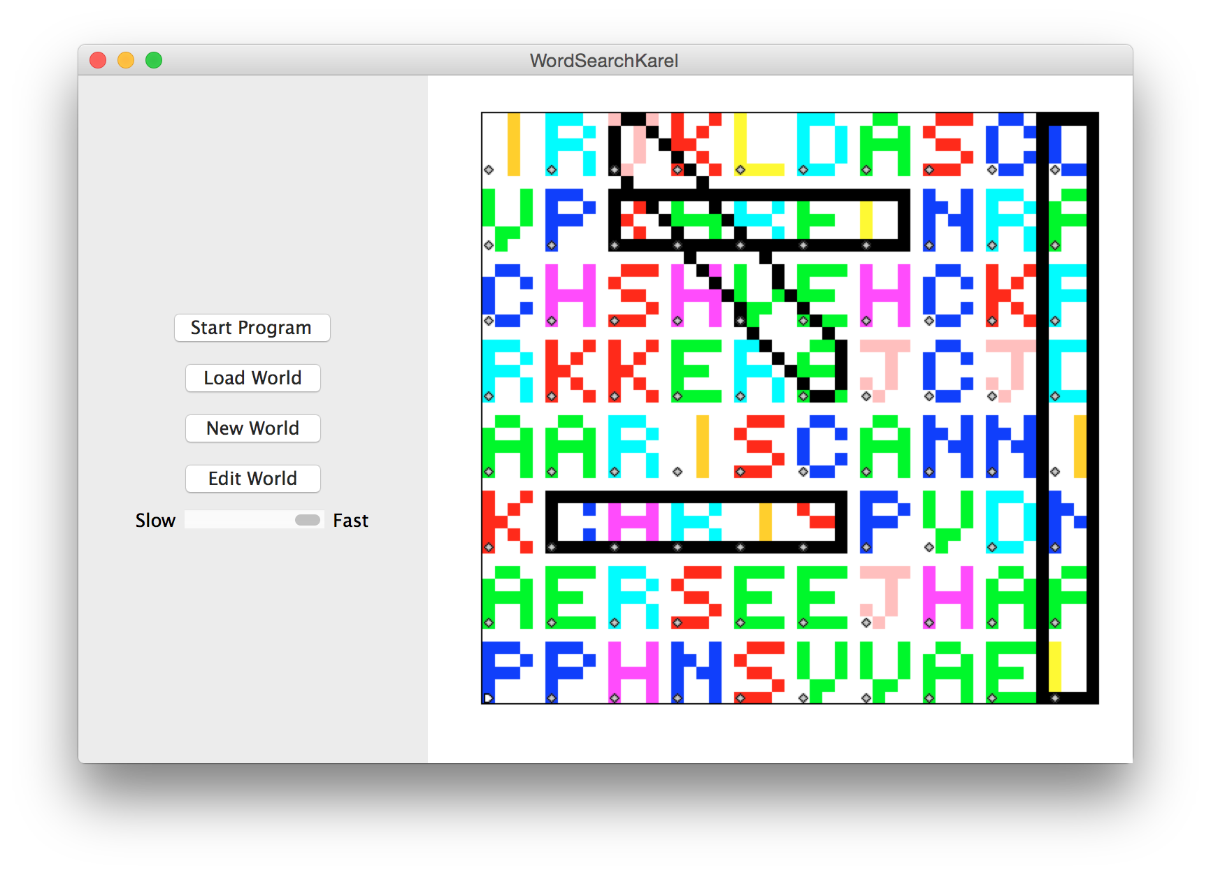

Slide 7
Quick review

Slide 8


Karel the Robot
s
Notes:
Tomorrow you will learn that Karel is actually a very gentle introduction to programming

Slide 9
Methods
import stanford.karel.*;
public class MethodExample extends SuperKarel {
public void run() {
goToMoon();
}
private void goToMoon() {
buildSpaceship();
// a few more steps
}
private void buildSpaceship() {
// todo
}
}

Slide 10
For Loops
import stanford.karel.*;
public class WhileExample extends SuperKarel {
public void run() {
// repeats the body 99 times
for(int i = 0; i < 99; i++) {
// the “body”
putBeeper();
}
}
}

Slide 11
While Loops
import stanford.karel.*;
public class WhileExample extends SuperKarel {
public void run() {
// while condition holds runs body
// checks condition after body completes
while(frontIsClear()) {
move();
}
}
}

Slide 12
If Statement
import stanford.karel.*;
public class IfExample extends SuperKarel{
public void run() {
// If the condition holds, runs body
if(frontIsClear()) {
move();
}
}
}

Slide 13
If / Else Statement
import stanford.karel.*;
public class IfExample extends SuperKarel{
public void run() {
// If the condition holds,
if(beepersPresent()) {
// do this
pickBeeper();
} else {
// otherwise, do this
putBeeper();
}
}
}

Slide 14
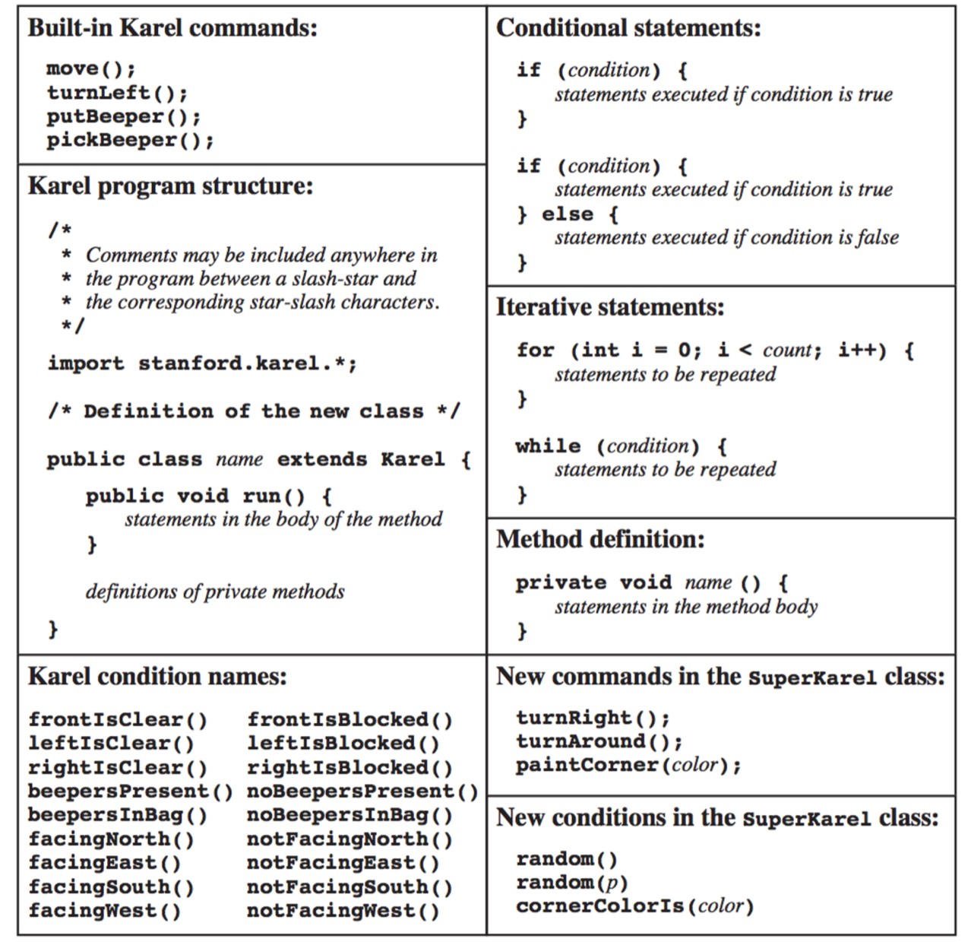
The Full Karel
Today we will use:
frontIsClear()
rightIsBlocked()
beepersPresent()

Slide 15
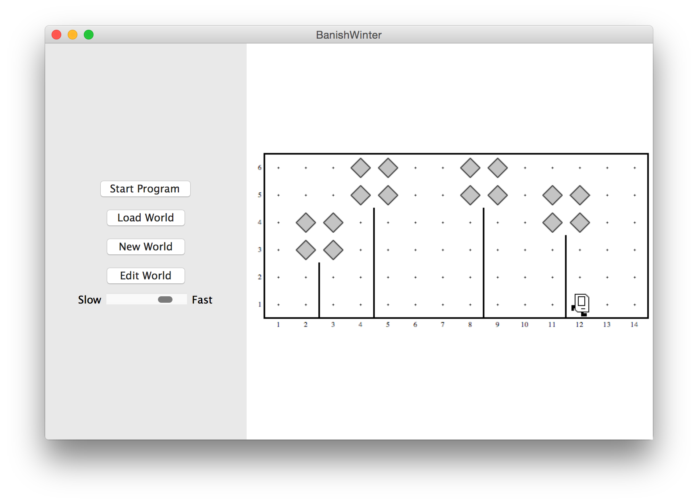
Banish Winter

Slide 16
End review

Slide 17
private void friday(){
banishWinter();
decomposition();
doubleBeepers();
rhoombaKarel();
if(extraTime()){
wordSearchKarel();
}
}

Slide 18
private void friday(){
banishWinter();
decomposition();
doubleBeepers();
rhoombaKarel();
if(extraTime()){
wordSearchKarel();
}
}

Slide 20
private void friday(){
banishWinter();
decomposition();
doubleBeepers();
rhoombaKarel();
if(extraTime()){
wordSearchKarel();
}
}

Slide 21
private void friday(){
banishWinter();
decomposition();
doubleBeepers();
rhoombaKarel();
if(extraTime()){
wordSearchKarel();
}
}

Slide 22
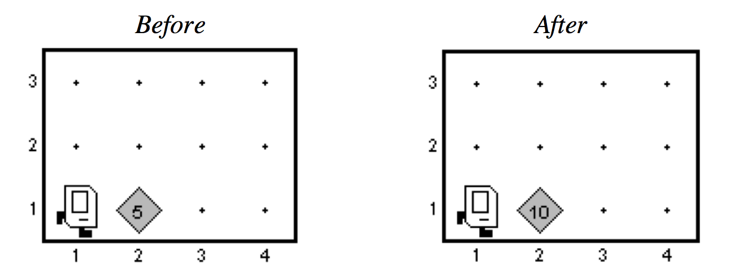
Double Beepers
Muhammed ibn Musa Al Kwarizmi

Slide 24
Aside: Common Errors
Lather,
Rinse,
Repeat

Slide 25

Infinite Loop
private void turnToWall() {
while(leftIsClear()) {
turnLeft();
}
}

Slide 26
Infinite Loop
private void turnToWall() {
while(leftIsClear()) {
turnLeft();
}
}

Slide 27
Infinite Loop
private void turnToWall() {
while(leftIsClear()) {
turnLeft();
}
}

Slide 28
Infinite Loop
private void turnToWall() {
while(leftIsClear()) {
turnLeft();
}
}

Slide 29

Off By One
private void fillRow() {
while(frontIsClear()) {
putBeeper();
move();
}
}

Slide 30
Pre/Post that Don’t Match
private void addLeavesToTrees() {
turnLeft();
climbTree();
addLeaves();
descendToGround();
turnLeft();
}
Post: facing East
Pre: facing South

Slide 31
End Aside
Lather,
Rinse,
Repeat

Slide 32
private void friday(){
banishWinter();
decomposition();
doubleBeepers();
rhoombaKarel();
if(extraTime()){
wordSearchKarel();
}
}

Slide 33
private void friday(){
banishWinter();
decomposition();
doubleBeepers();
rhoombaKarel();
if(extraTime()){
wordSearchKarel();
}
}

Slide 34

Rhoomba Karel
Write a Roomba Karel that sweeps the entire world of all beepers.
Karel starts at (1,1) facing East.
The world is rectangular, and some squares contain beepers.
There are no interior walls.
When the program is done, the world should contain 0 beepers.
Karel's ending location does not matter.
How should we approach this tricky problem?
8
.
.
.
.
.
.
.
.
7
.
.
.
.
.
.
.
.
6
.
.
.
.
.
.
.
.
5
.
.
.
.
.
.
.
.
4
.
.
.
.
.
.
.
.
3
.
.
.
.
.
.
.
.
2
.
.
.
.
.
.
.
.
1
.
.
.
.
.
.
.
.
1
2
3
4
5
6
7
8

Slide 35
Possible Algorithm 1
8
.
.
.
.
.
.
.
.
7
.
.
.
.
.
.
.
.
6
.
.
.
.
.
.
.
.
5
.
.
.
.
.
.
.
.
4
.
.
.
.
.
.
.
.
3
.
.
.
.
.
.
.
.
2
.
.
.
.
.
.
.
.
1
.
.
.
.
.
.
.
.
1
2
3
4
5
6
7
8

Slide 36
Possible Algorithm 2
8
.
.
.
.
.
.
.
.
7
.
.
.
.
.
.
.
.
6
.
.
.
.
.
.
.
.
5
.
.
.
.
.
.
.
.
4
.
.
.
.
.
.
.
.
3
.
.
.
.
.
.
.
.
2
.
.
.
.
.
.
.
.
1
.
.
.
.
.
.
.
.
1
2
3
4
5
6
7
8

Slide 37
Possible Algorithm 3
8
.
.
.
.
.
.
.
.
7
.
.
.
.
.
.
.
.
6
.
.
.
.
.
.
.
.
5
.
.
.
.
.
.
.
.
4
.
.
.
.
.
.
.
.
3
.
.
.
.
.
.
.
.
2
.
.
.
.
.
.
.
.
1
.
.
.
.
.
.
.
.
1
2
3
4
5
6
7
8

Slide 38
Possible Algorithm 4
8
.
.
.
.
.
.
.
.
7
.
.
.
.
.
.
.
.
6
.
.
.
.
.
.
.
.
5
.
.
.
.
.
.
.
.
4
.
.
.
.
.
.
.
.
3
.
.
.
.
.
.
.
.
2
.
.
.
.
.
.
.
.
1
.
.
.
.
.
.
.
.
1
2
3
4
5
6
7
8

Slide 39
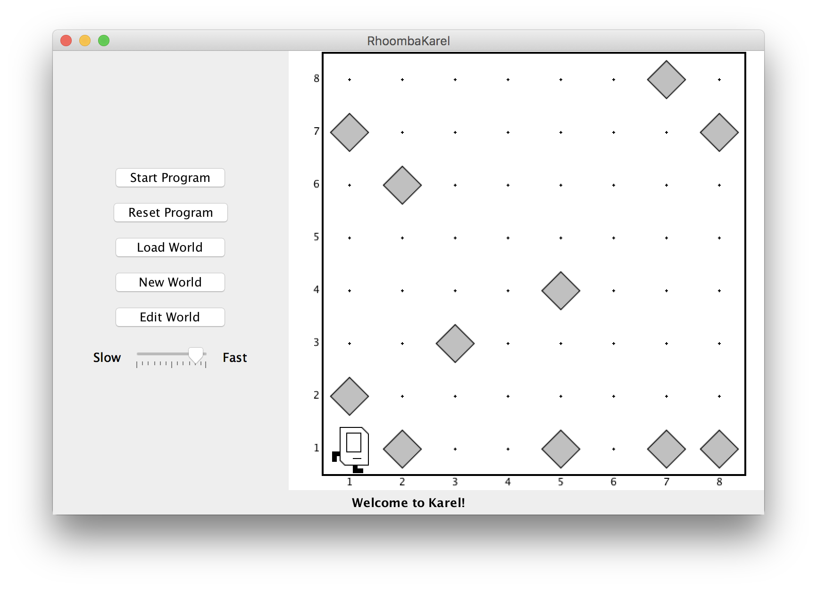
Rhoomba Karel

Slide 40
private void friday(){
banishWinter();
decomposition();
doubleBeepers();
rhoombaKarel();
if(extraTime()){
wordSearchKarel();
}
}

Slide 41
private void friday(){
banishWinter();
decomposition();
doubleBeepers();
rhoombaKarel();
if(extraTime()){
wordSearchKarel();
}
}

Slide 42
private void friday(){
banishWinter();
decomposition();
doubleBeepers();
rhoombaKarel();
if(extraTime()){
wordSearchKarel();
}
}

Slide 44
Happy Friday

